Slide 1
ADVANCED JAVA PROGRAMMING SEMINAR
- TEAM 3

Slide 2
PROGRAM 9
Design and implement a simple Client Server Application using RMI.

Slide 3
STEPS INVOLVED:
Define the remote interface.
Develop the implementation class (remote object)
Develop the server program.
Develop the client program.
Compile the application.
Execute the application.

Slide 4
SOFTWARE REQUIRED:
1. JAVA
2. COMMAND PROMPT

Slide 5
CODES

Slide 6
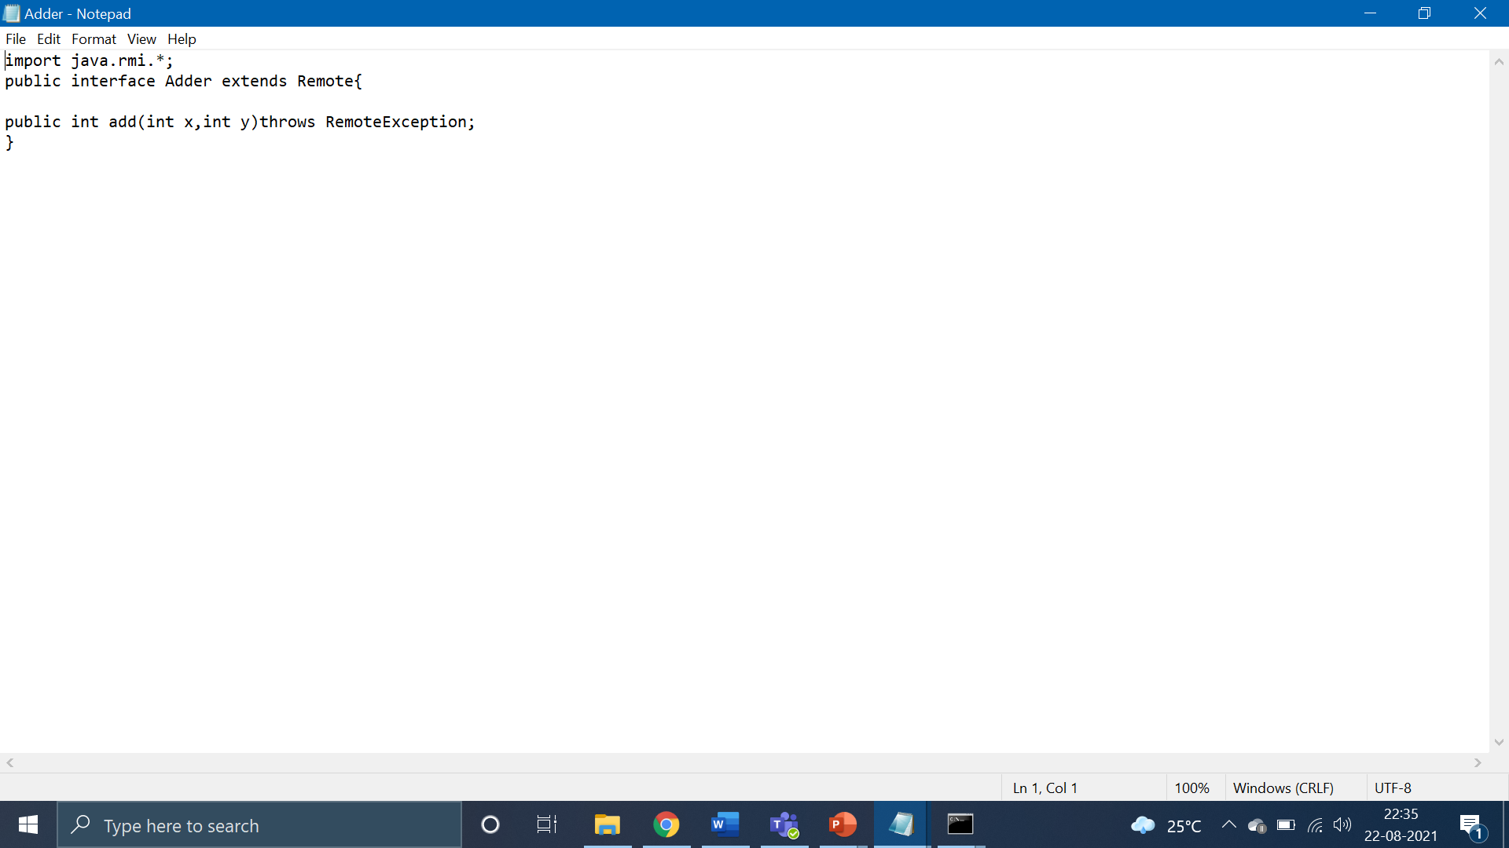

Slide 7
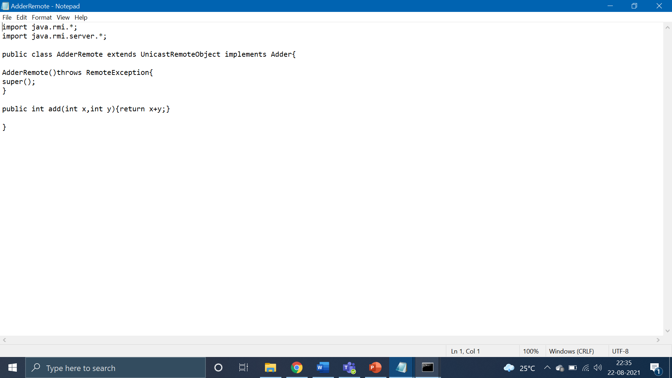

Slide 8
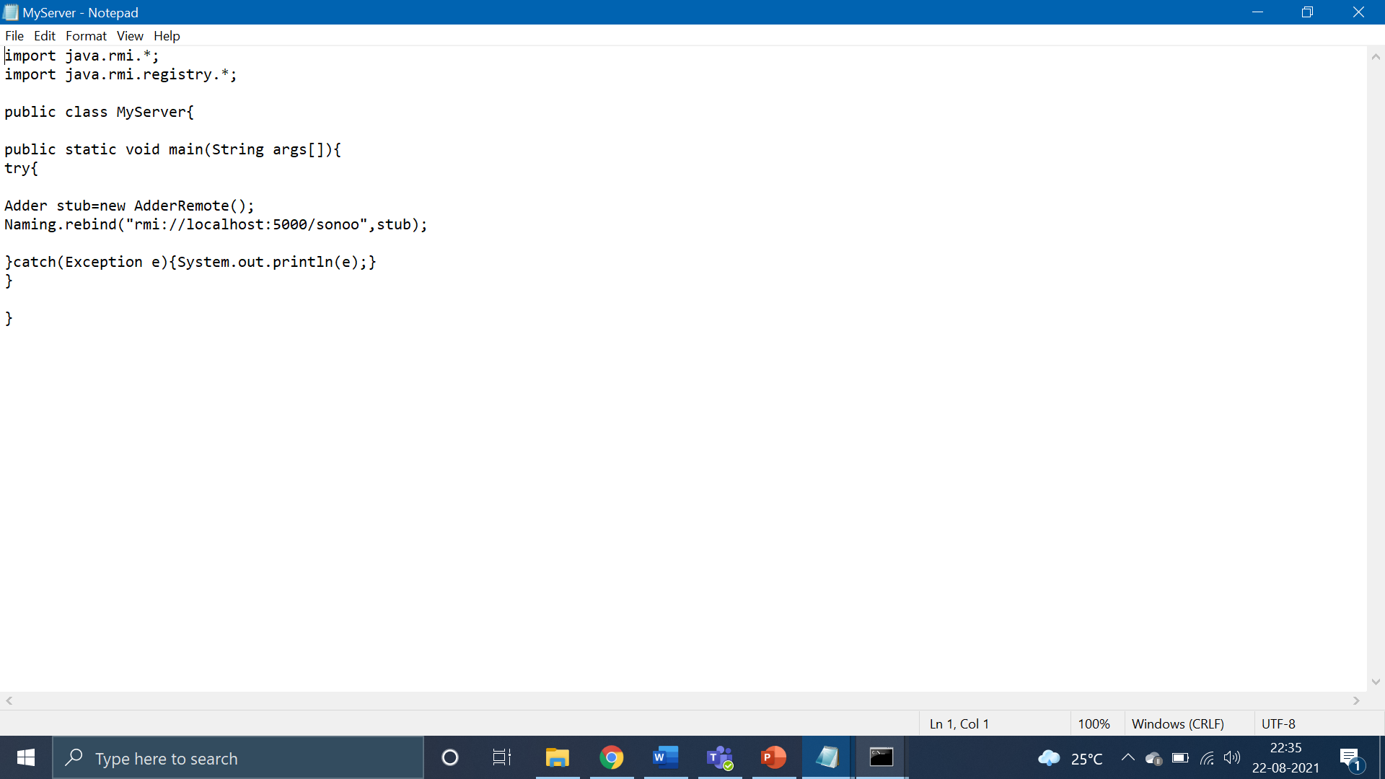

Slide 9
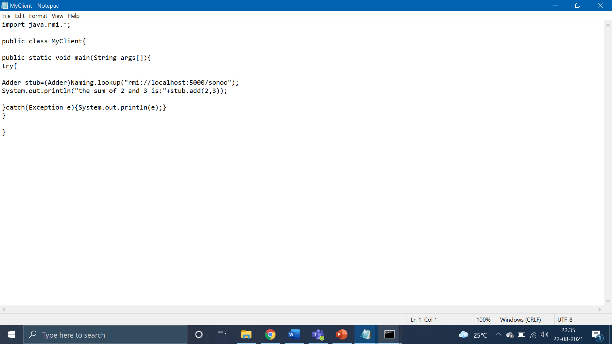

Slide 10
OUTPUT:

Slide 11
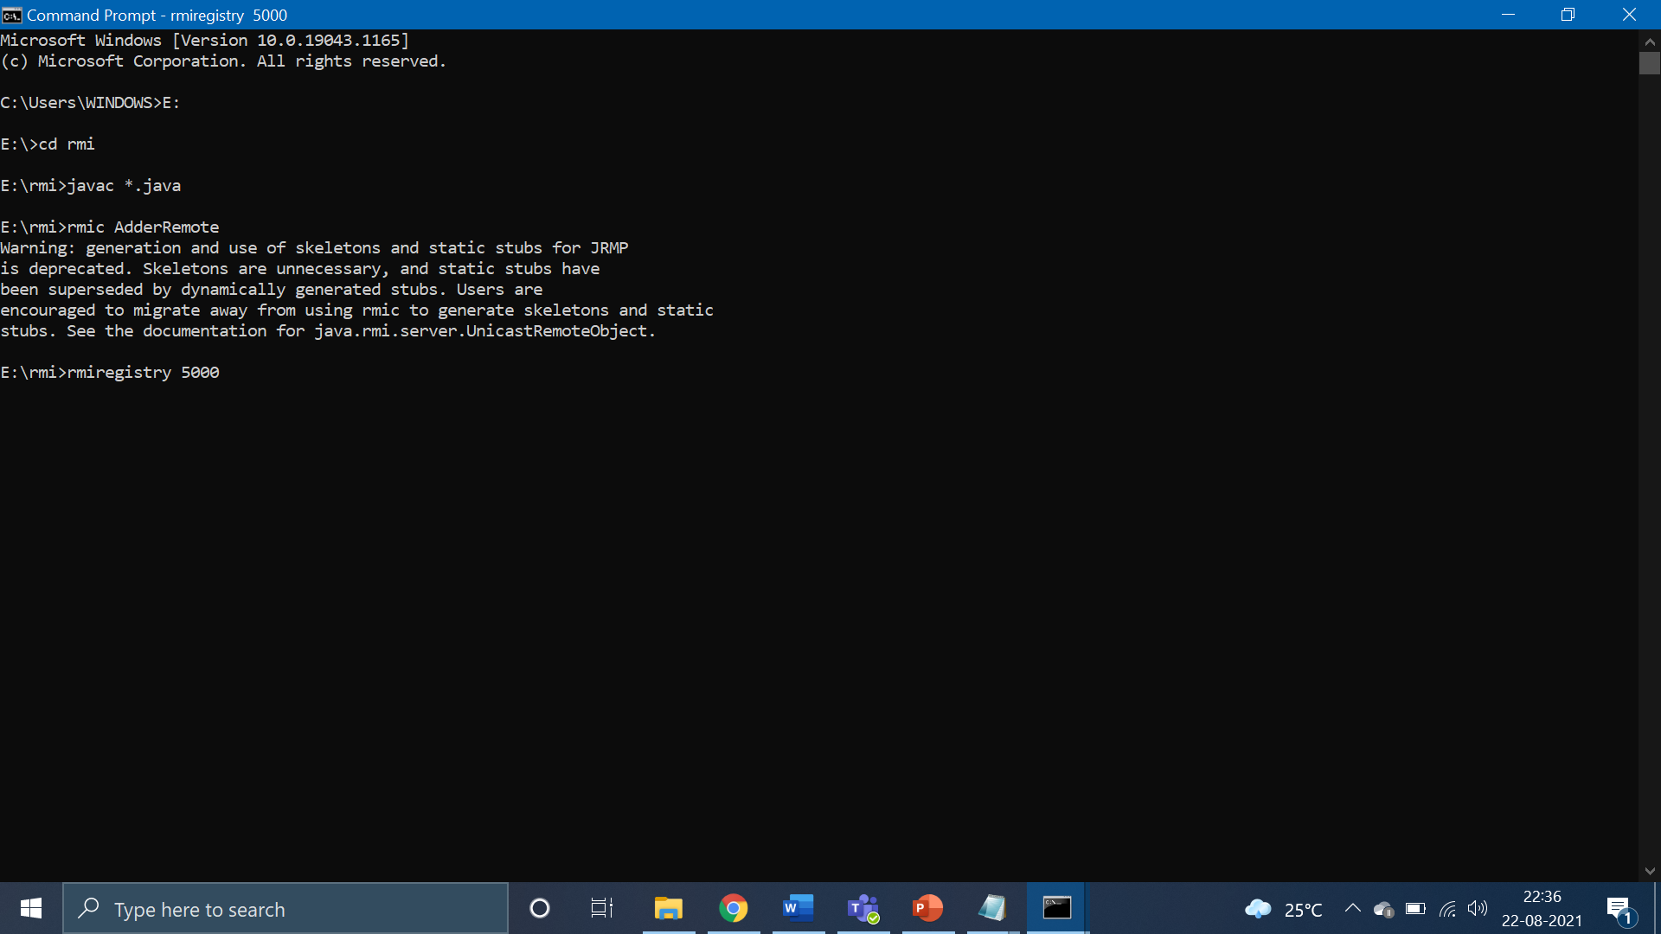

Slide 12
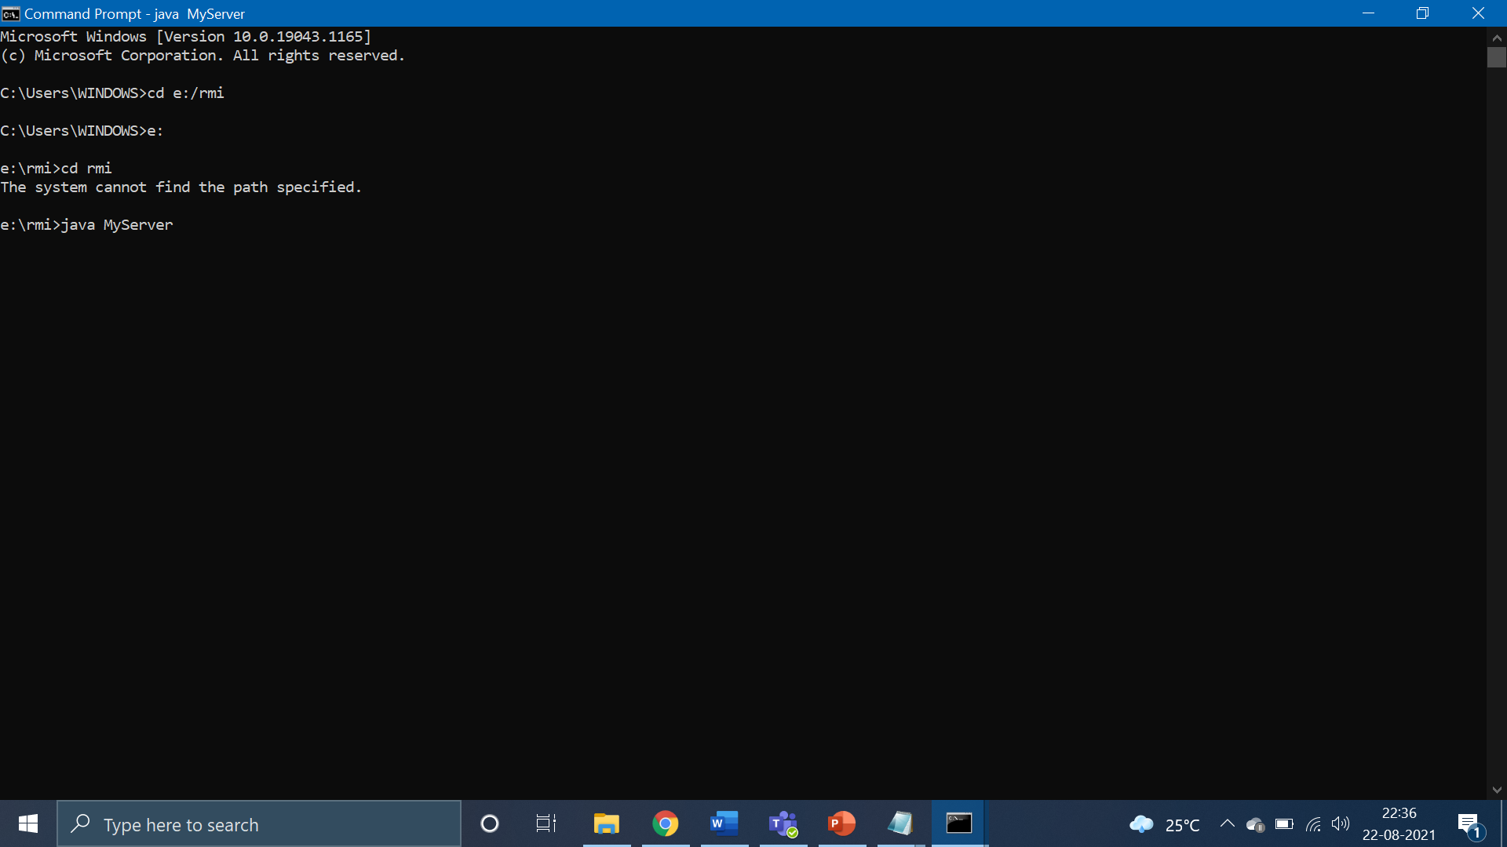

Slide 13
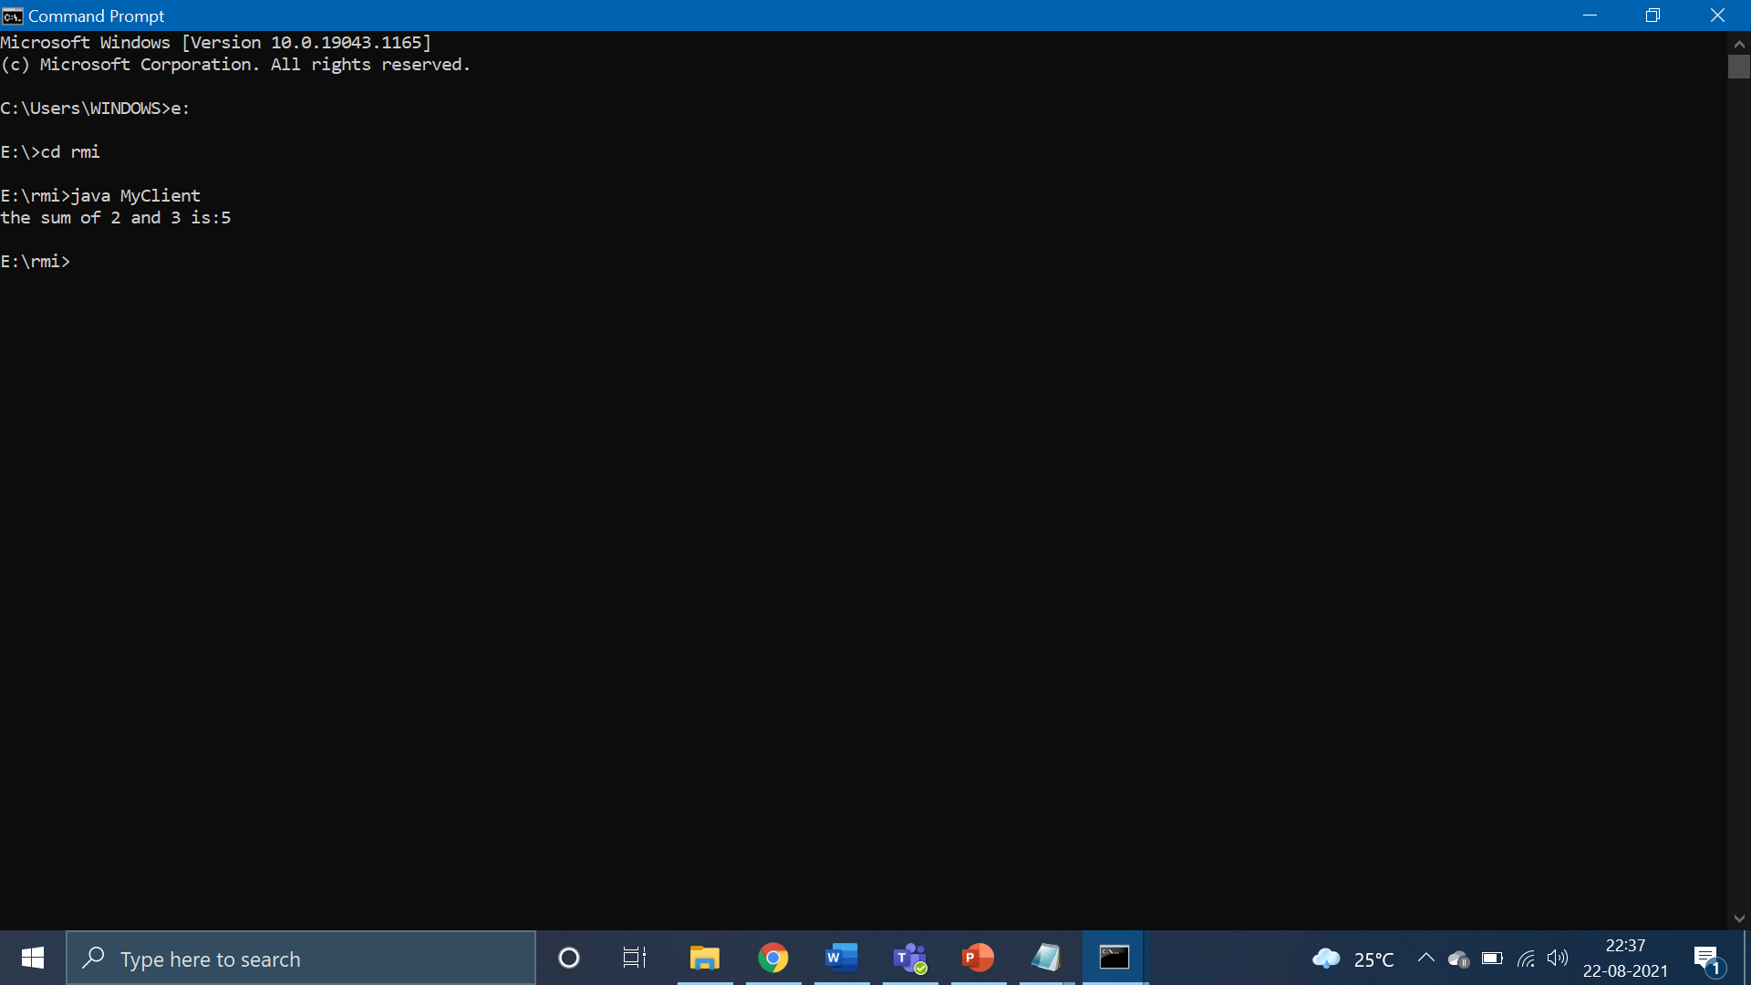

Slide 14
THANK YOU!

